Slide 1
R-Ladies
Melbourne
Launch Meetup
18 October 2016

Slide 2


Thanks to Zendesk!

Slide 3



















Thanks to Our Sponsors!
Data Science Meetup
and its sponsors

Slide 4
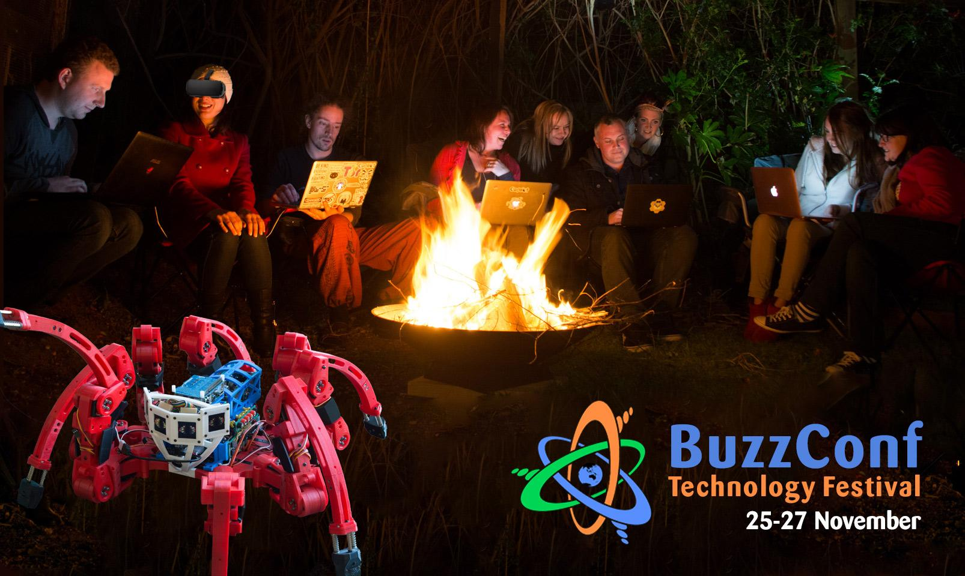

Thanks to BuzzConf!

Slide 5


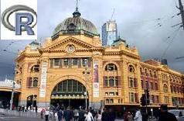
Thanks!
Bakes by Jean
Melbourne Users of R Meetup

Slide 6
Outline
History of R-Ladies Global
Aims of R-Ladies Global
Some Statistics
R-Ladies Melbourne

Slide 7
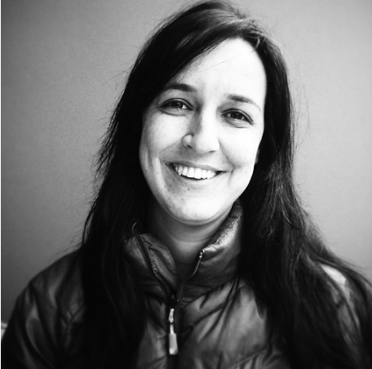
First Initiative
Huge thanks to Gabriella!!
Gabriela de Queiroz founded the
R-Ladies in San Francisco in October 2012!
R-Ladies have recently celebrated their 4th year anniversary!

Slide 8
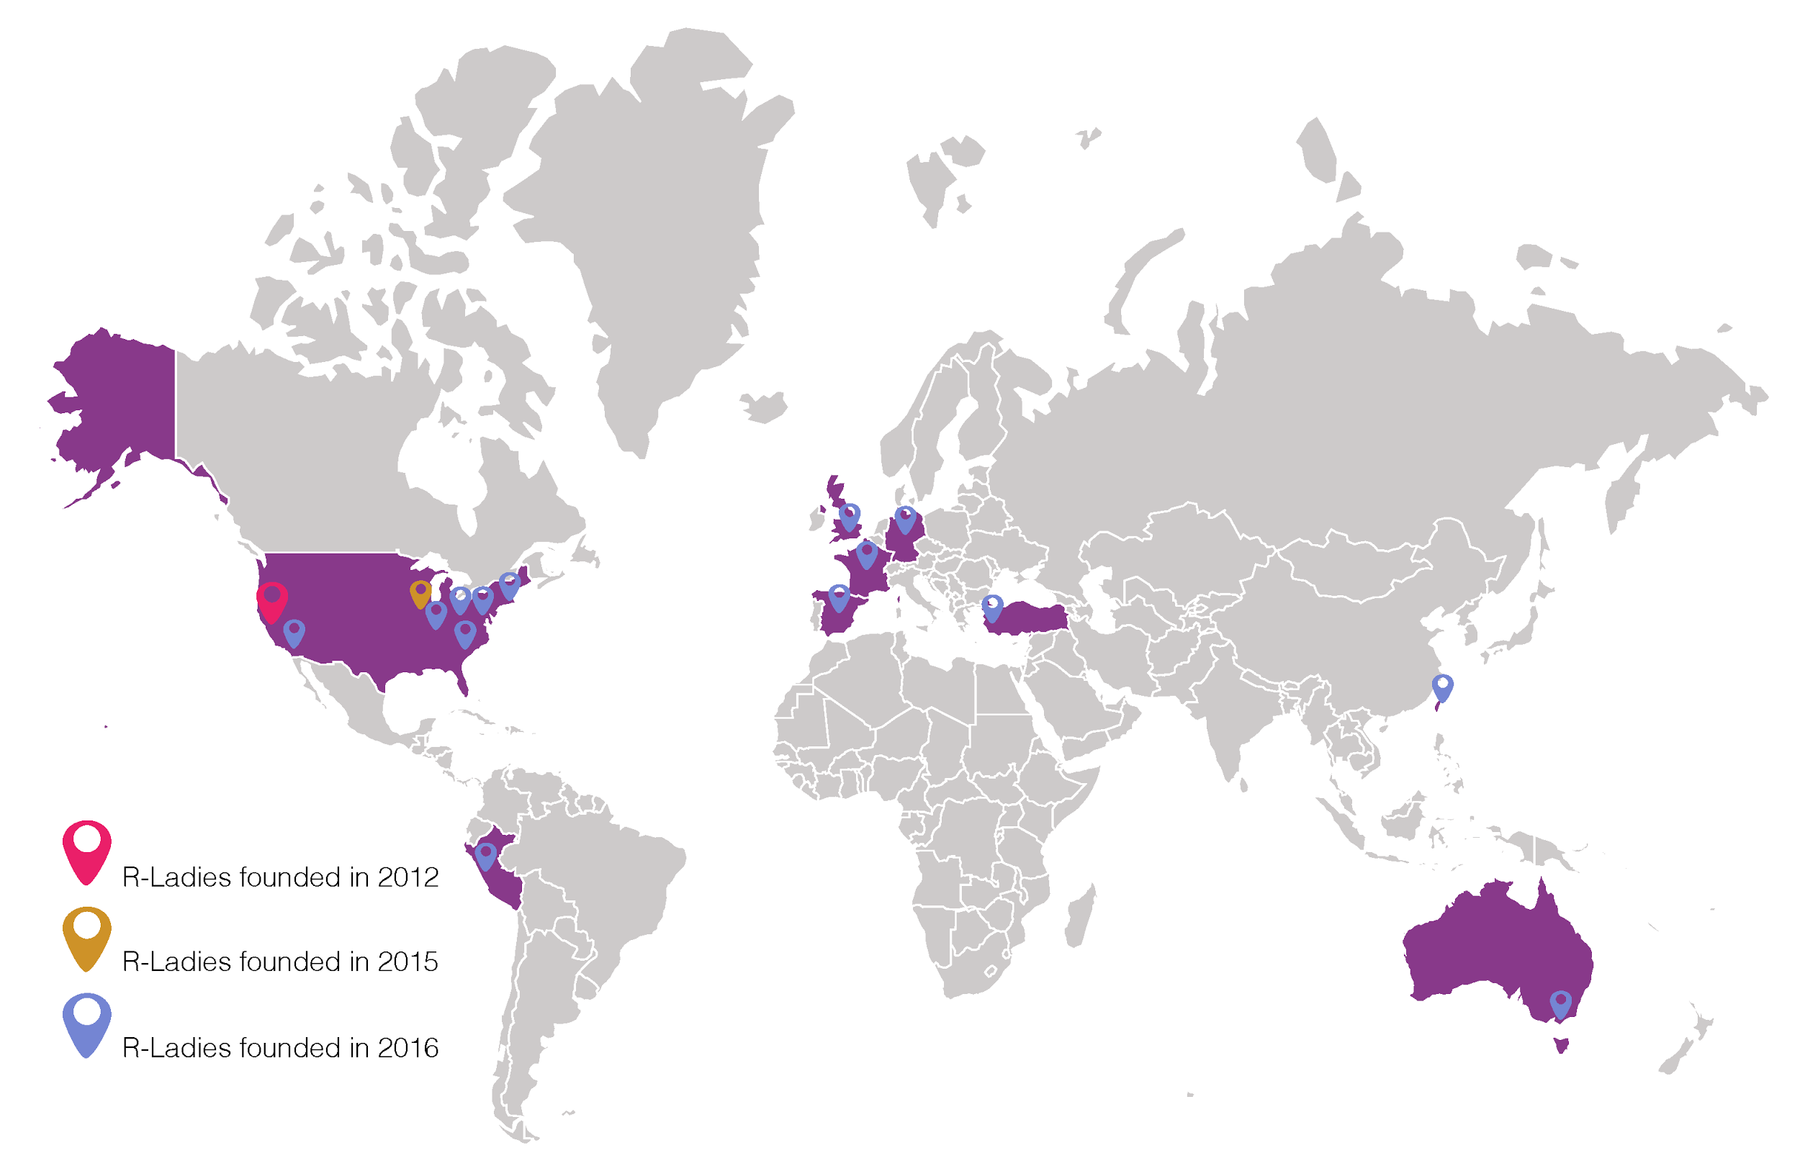
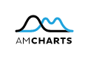
R-Ladies Global
Today there are groups in sixteen cities around the world
source: https://rladies.org/ladies/

Slide 9
R-Ladies Goals
Increase the participation of women in the R community
Create an R women users and developers database
Encourage women to write R codes, develop packages and attend to the R conferences as speaker

Slide 10
R-Ladies Achievements
More women are developing packages now
More women became part of the R community
A database for women R users is available Speaker R-Ladies
Fill the form on https://rladies.org/ladies/

Slide 11
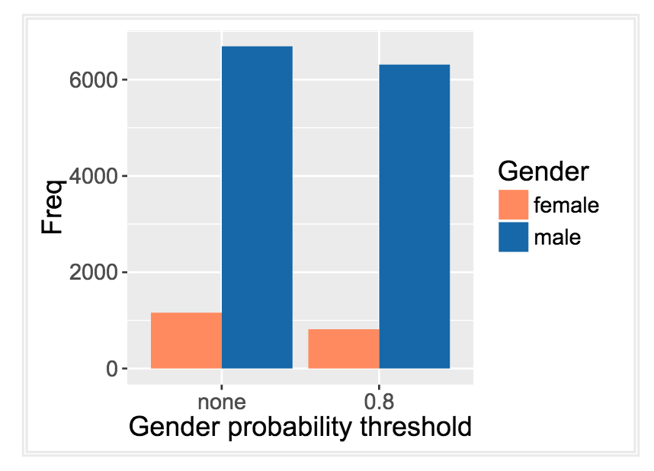
Gender Statistics
Only ~ 15% of R package authors are women
(Estimates produced with CRAN package genderizeR, as on March 2016)

Slide 12
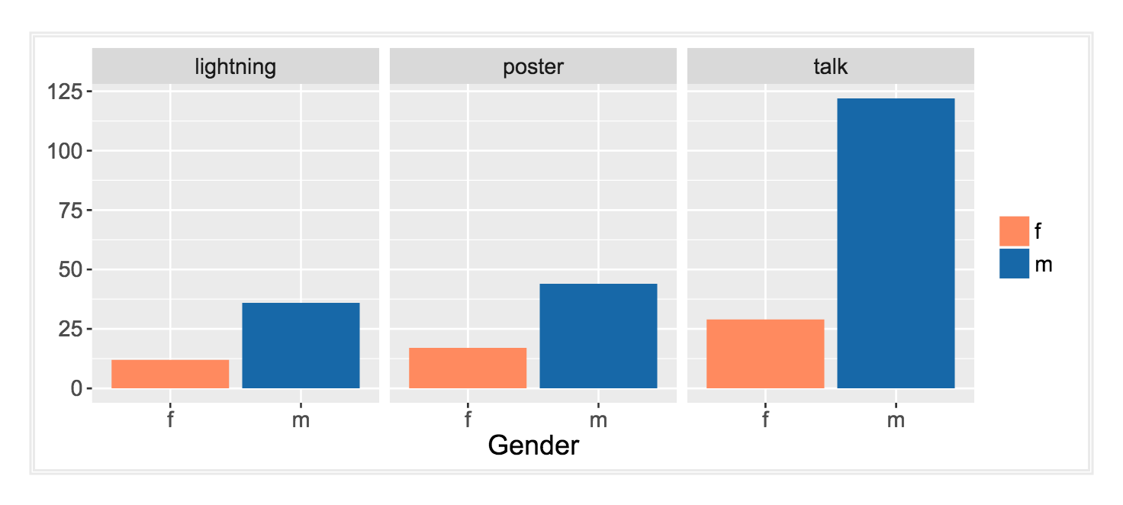
Statistics from useR! 2016

Slide 13
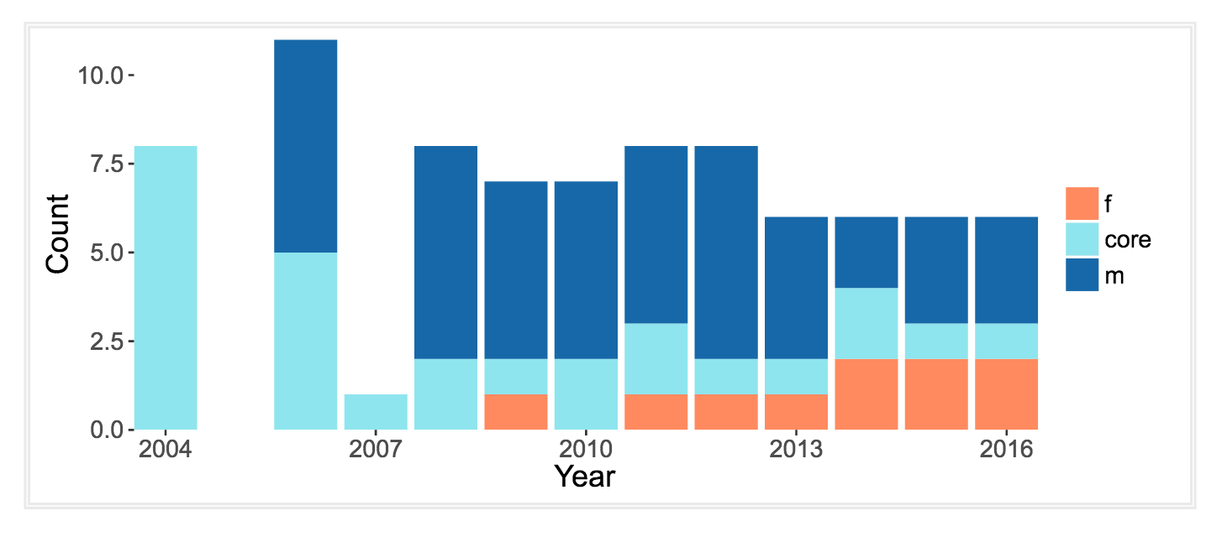
Increase in female keynotes at useR!
core = R core members = male

Slide 14
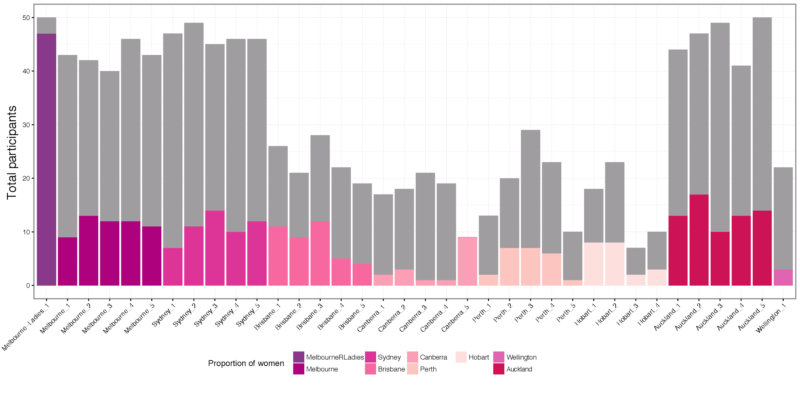
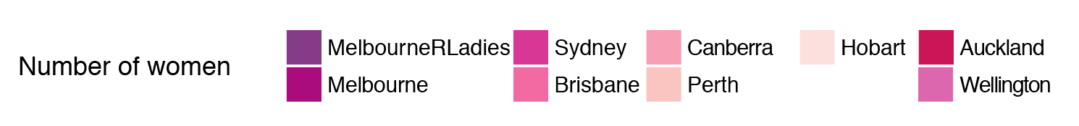
Women in R
Australia & New Zealand
Women participating at R user group meetups
Estimates obtained with genderizeR. No threshold applied to the probability.

Slide 15
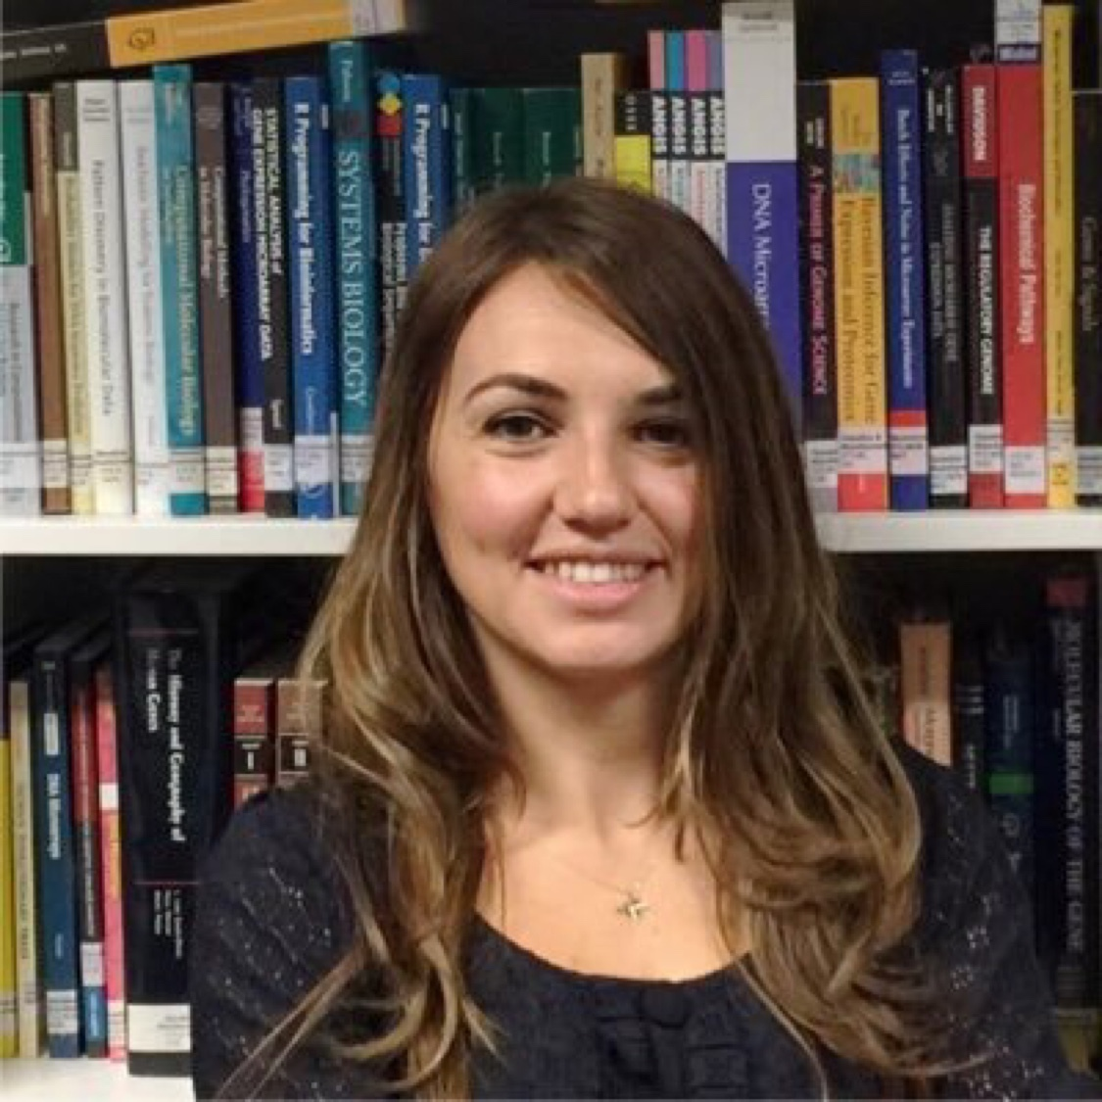
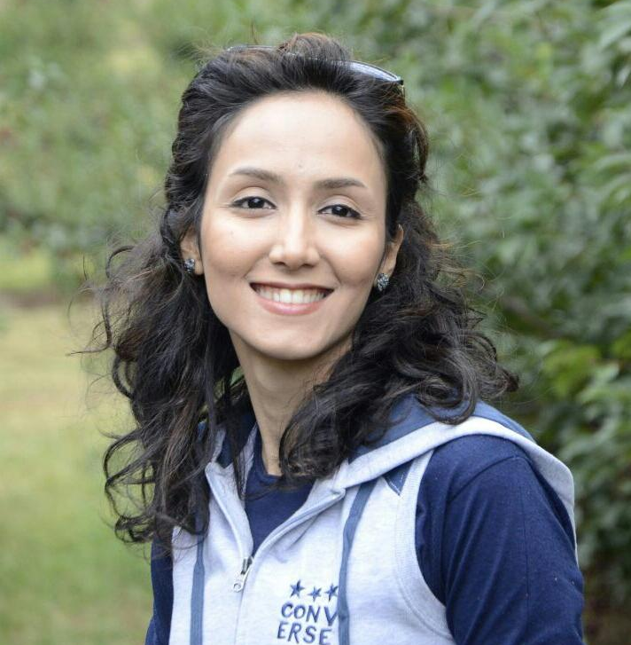
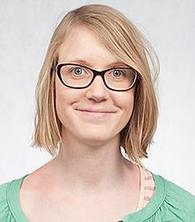
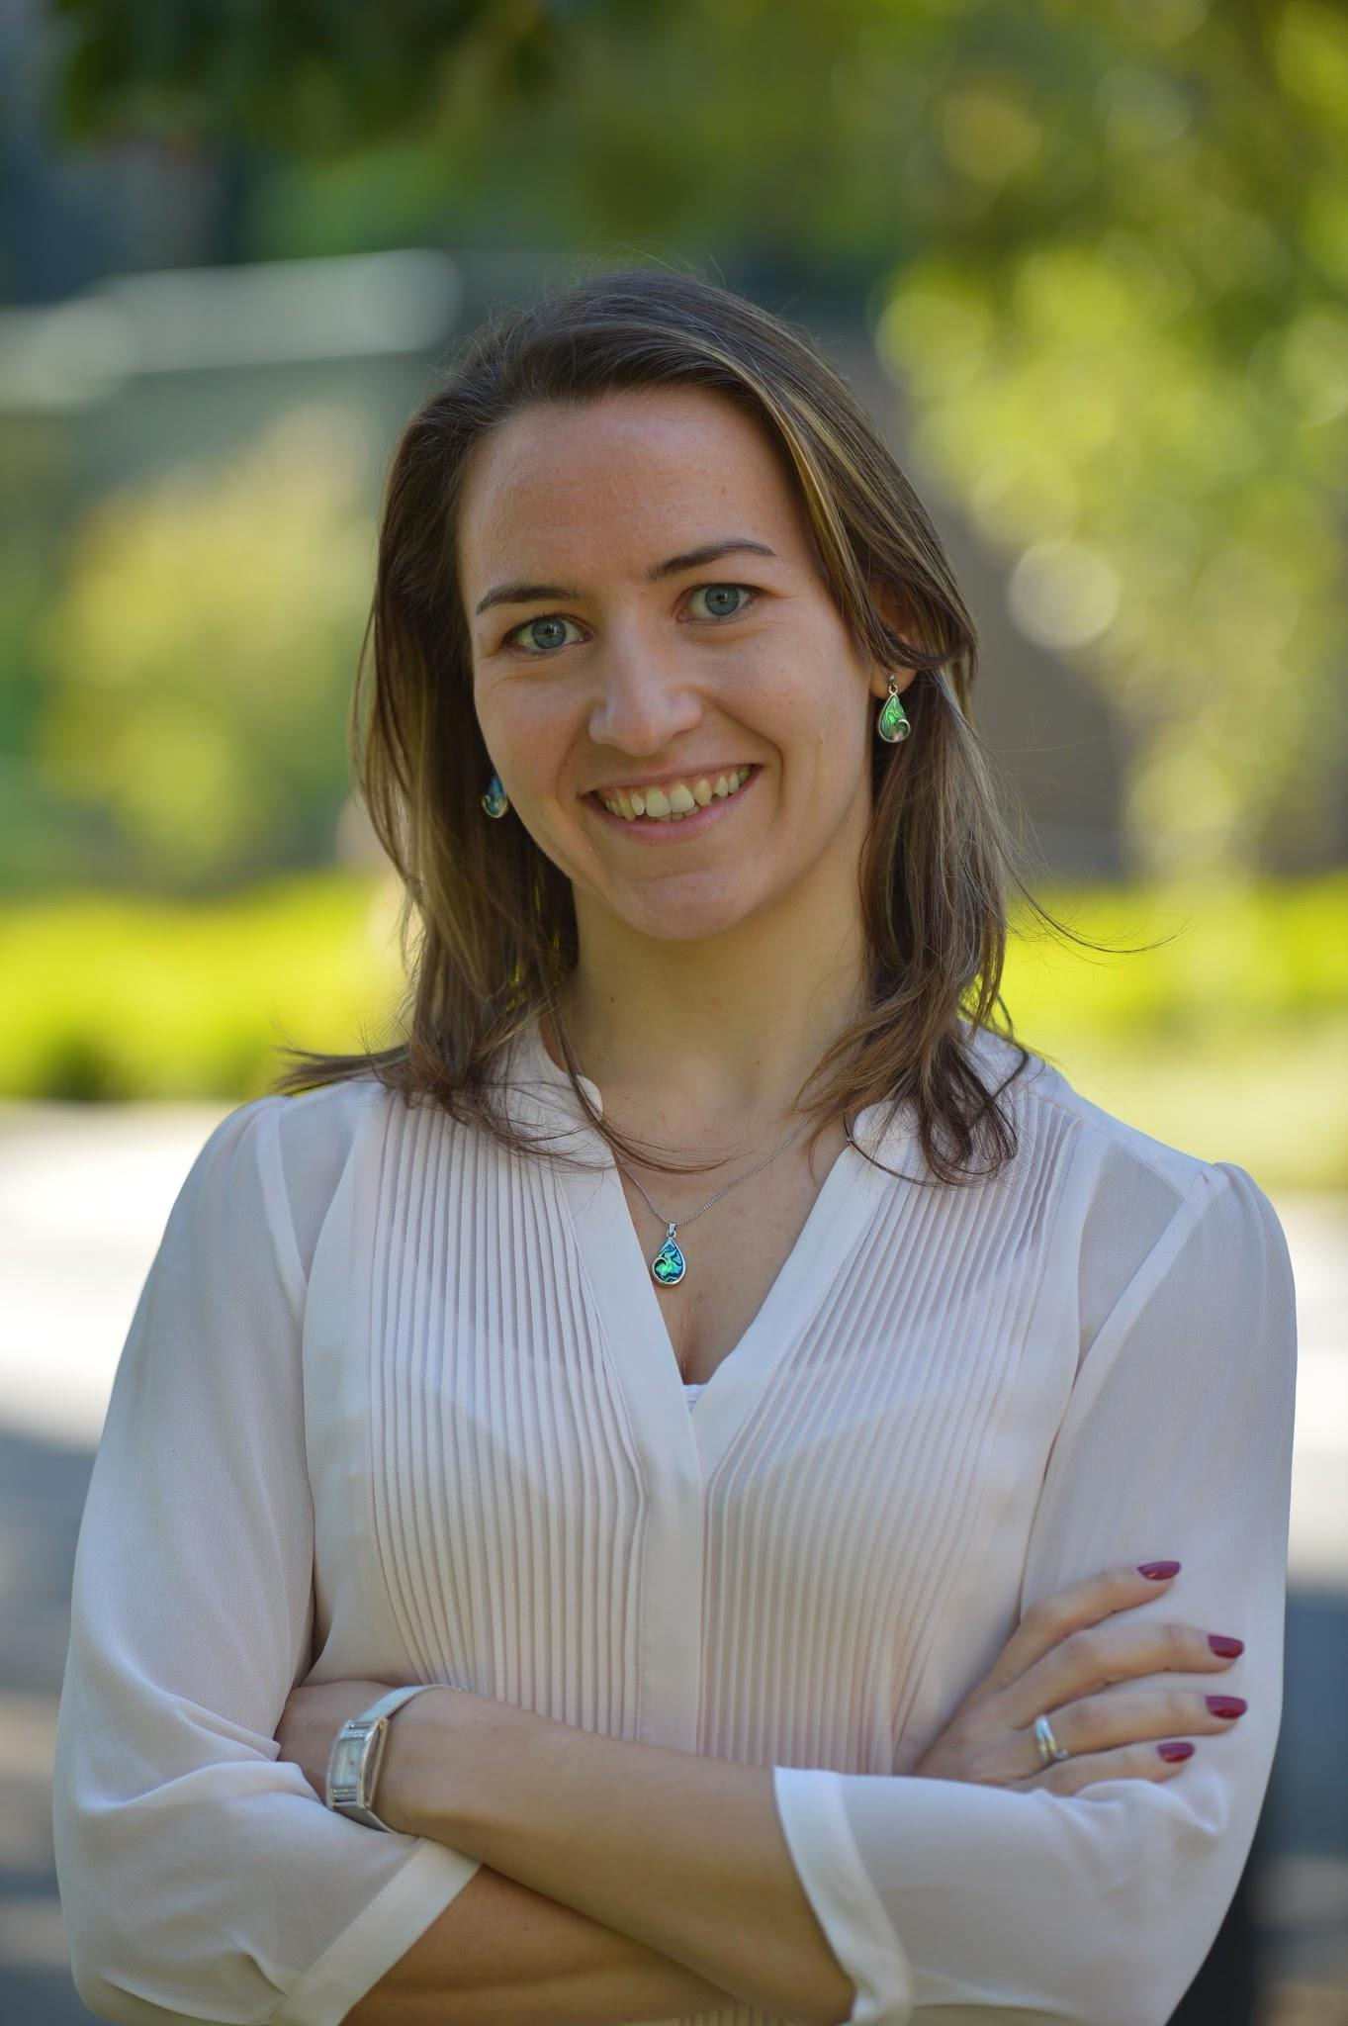
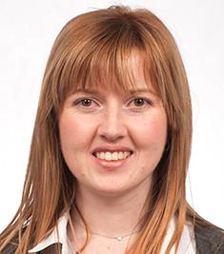
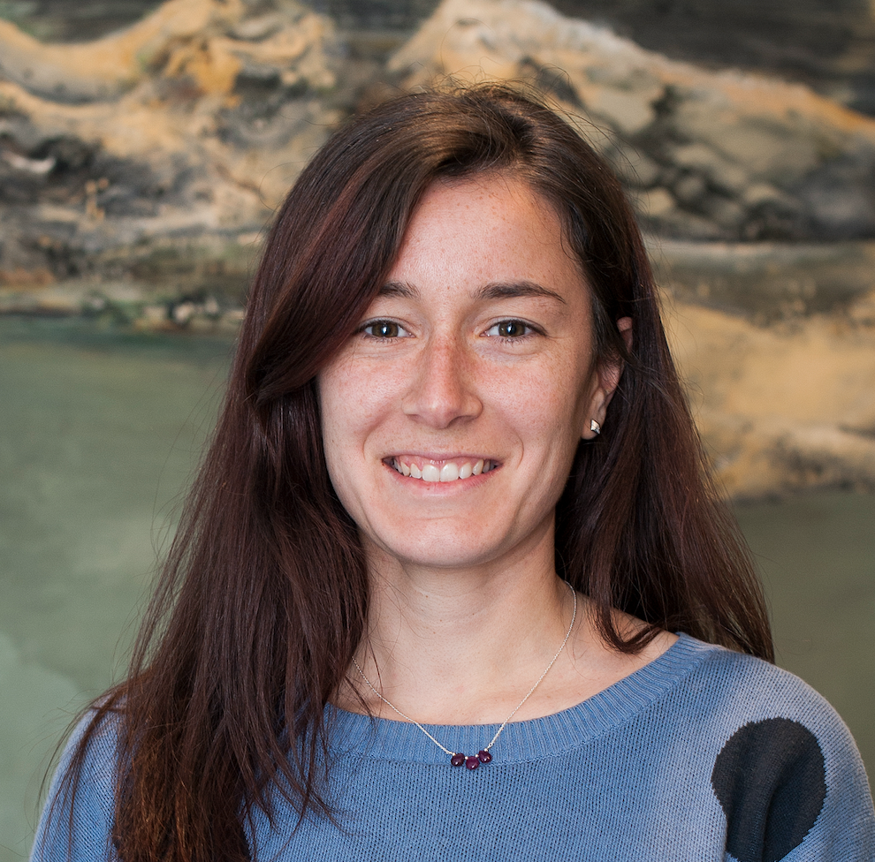
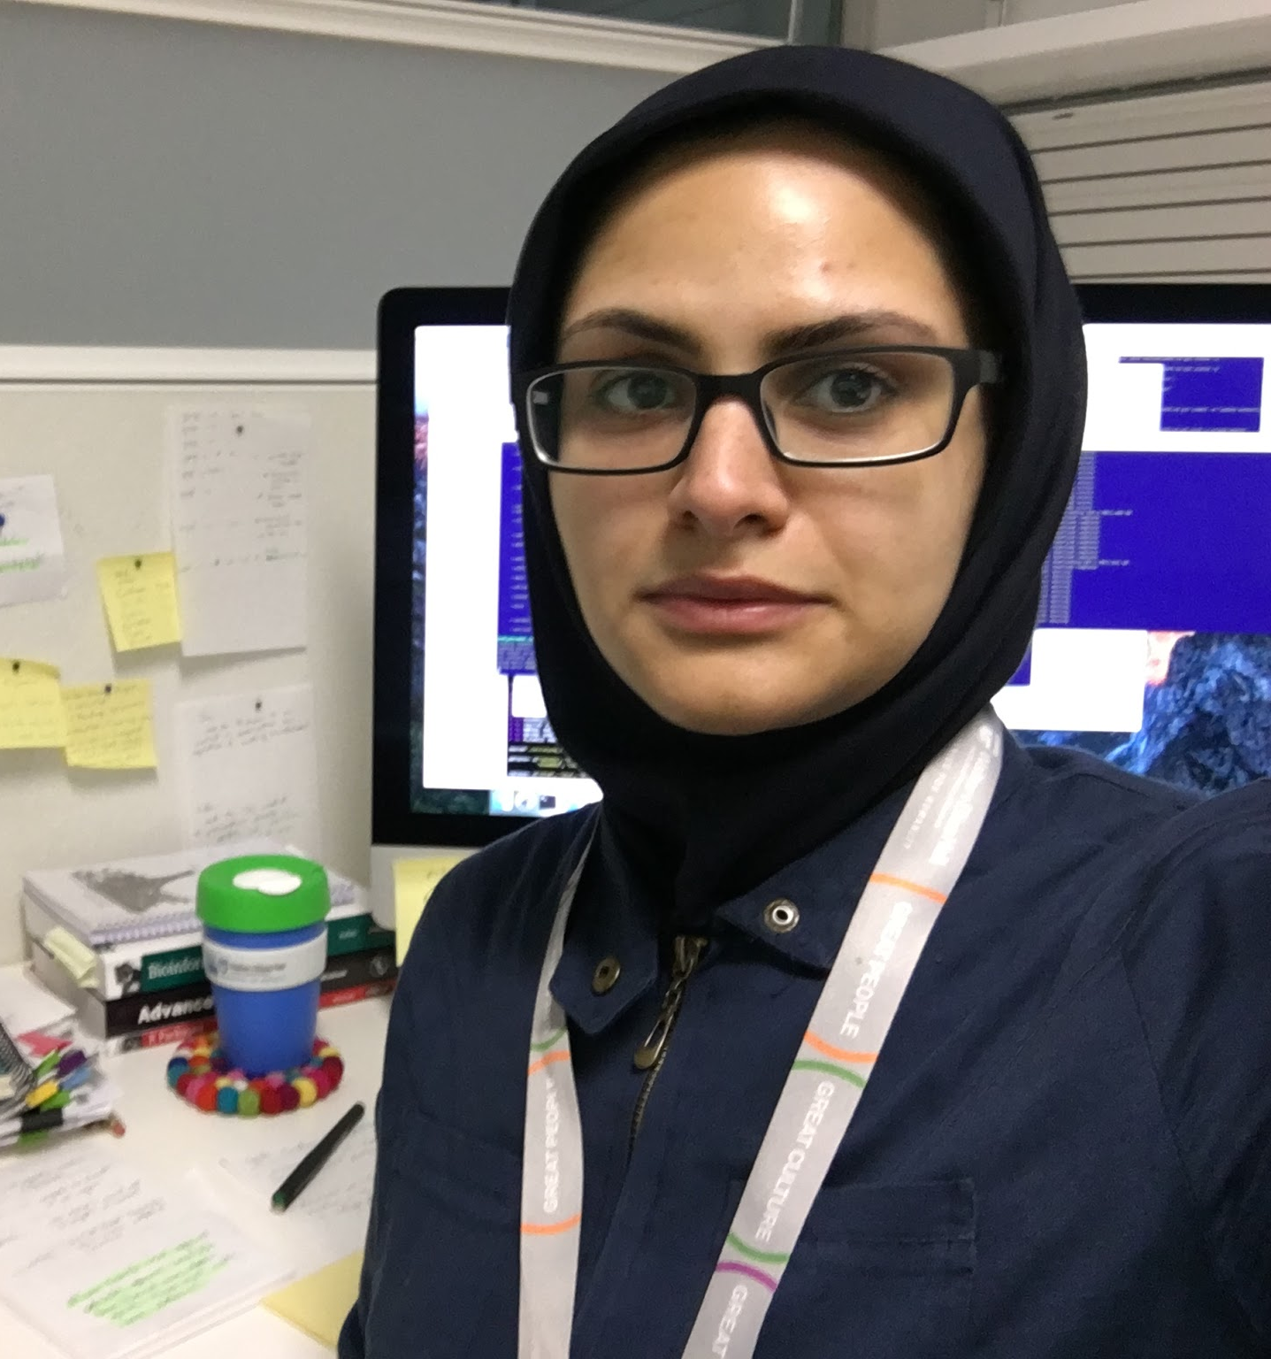
R-Ladies Melbourne Organisers
Göknur Giner
Sepideh Foroutan
Saskia Freytag
Roxane Legaie
Alexandra Garnham
Anna Quaglieri
Soroor Zadeh

Slide 16

Want to know more?
Website
Want to start a new #RLadies chapter in your city?
Email info@rladies.org
Follow @RLadiesGlobal

Slide 17
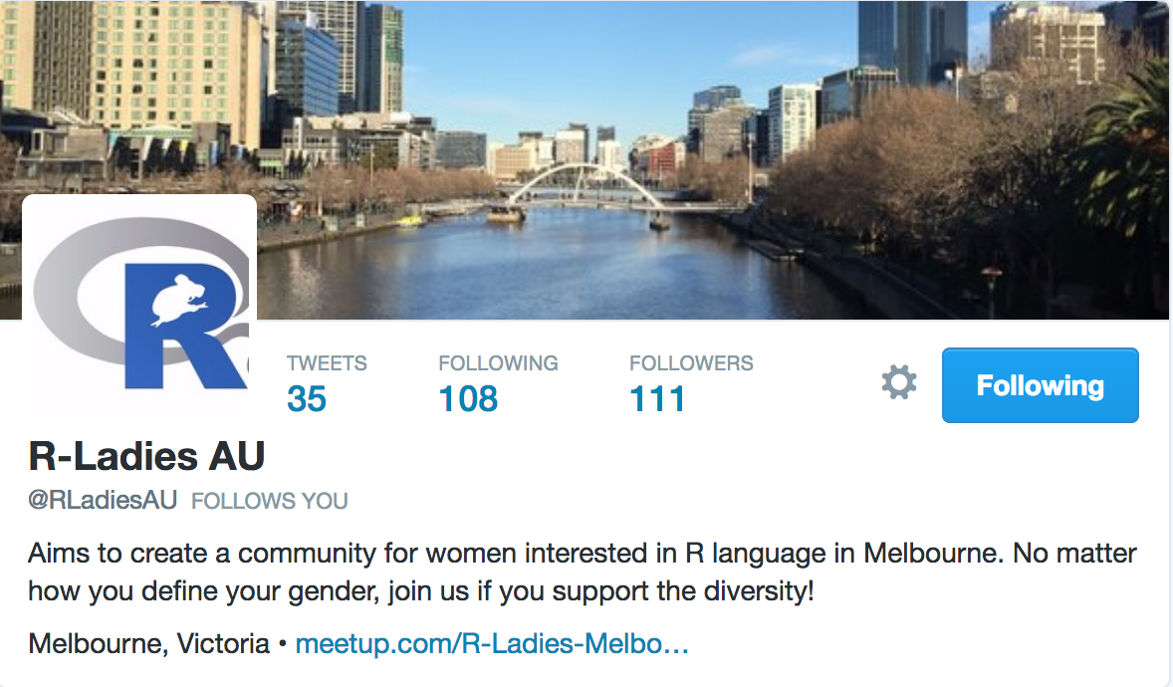
Support us on Twitter...
Follow us @RLadiesAU and other R-Ladies groups.
Tweet our R events (conference, workshops, etc.)
Tweet opportunities for R-Ladies (job, grant, etc)
Like/retweet our tweets!
Support and advertise women activities.

Slide 18
Profiling Survey Results
Thanks for your participation!

Slide 19
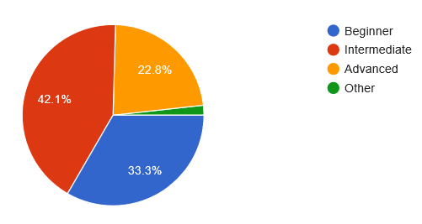
Level in R?

Slide 20
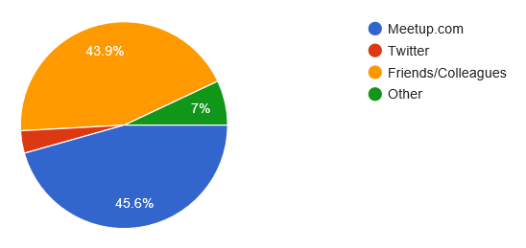
How did you hear about R-Ladies Melbourne?

Slide 21
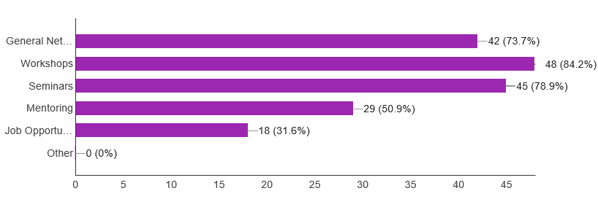
What would you like to see at our events?

Slide 22
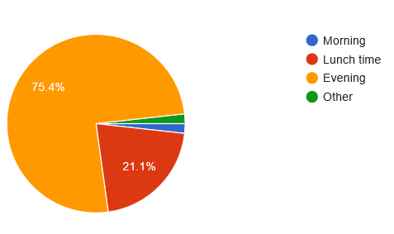
Best time for you to attend our events?

Slide 23
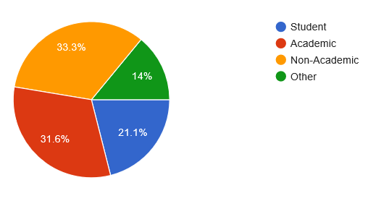
Professional status

Slide 24
Would you like to get involved?
Please email us: rladiesmelbourne@gmail.com

Slide 25

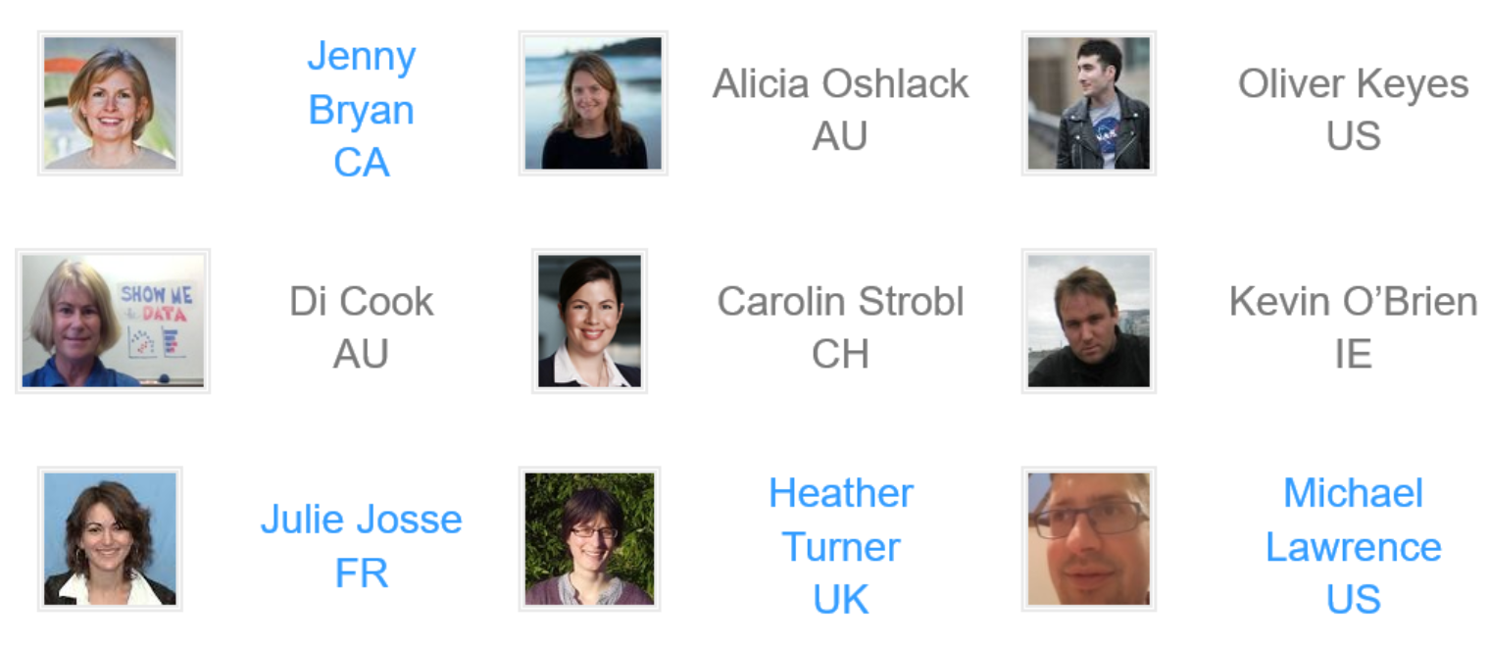
Women in R TaskForce

